Slide 1
ACCURACY & F1 SCORE COMPARISON BETWEEN TOP THREE MODELS
TFIDF = 10000 Features, N-Gram=(1,2), test split=0.2
When considered 5 Classes : Ratings 1 to 5
Logistic Regression
Training Accuracy : 80.08 Testing Accuracy : 44.05 Training F1 Score : 80.64 Testing F1 Score : 54.21
SVM
Training Accuracy : 96.27
Testing Accuracy : 44.06
Training F1 Score : 96.28
Testing F1 Score : 56.51
Neural Network
Training Accuracy : 91.08
Testing Accuracy : 41.18
Training F1 Score : 91.06
Testing F1 Score : 48.27
When considered 3 Classes : 0-Negative, 1-Neutral, 2-Positive
Logistic Regression
Training Accuracy : 90.47
Testing Accuracy : 71.7
Training F1 Score : 91.9
Testing F1 Score : 79.04
SVM
Training Accuracy : 97.36
Testing Accuracy : 72.55
Training F1 Score : 97.48
Testing F1 Score : 81.21
Neural Network
Training Accuracy : 96.6
Testing Accuracy : 72.74
Training F1 Score : 96.63
Testing F1 Score : 81.61

Slide 2
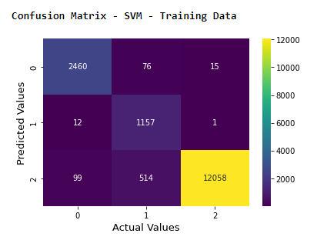
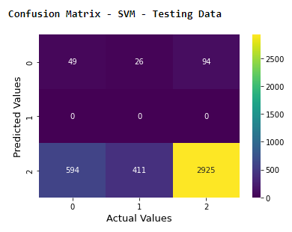
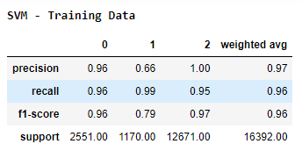
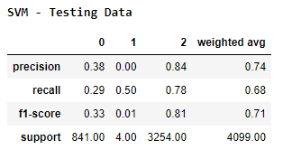
FINAL MODEL - SVM
Training Accuracy : 97.36
Testing Accuracy : 72.55
Training F1 Score : 97.48
Testing F1 Score : 81.21

